Slide 1

STRATEGY PLAN

Slide 2
WHO/WHAT IS MAX AND RILEY
-ON TREND
-NY/ LA STYLE STREET WEAR
- FUN/FUNKY

Slide 3
GOALS
To gain and maintain followers
10.8 K +
Gain followers who are interactive, and see this follower count convert into sales.
Have customers be more aware of services, brands, and campaigns.
Tweak media strategy (Instagram mainly) to see results.

Slide 4
How ?
Cohesive layout
Detail oriented
Call to Action
Switching up content
Emotion based marketing
Showcase featured pieces, style in outfits, provide details, motivation to purchase.

Slide 5
INSTAGRAM - PRESETS
COHESIVE LOOK
EASY ON THE EYE
VISUALLY APPEALING

Slide 6
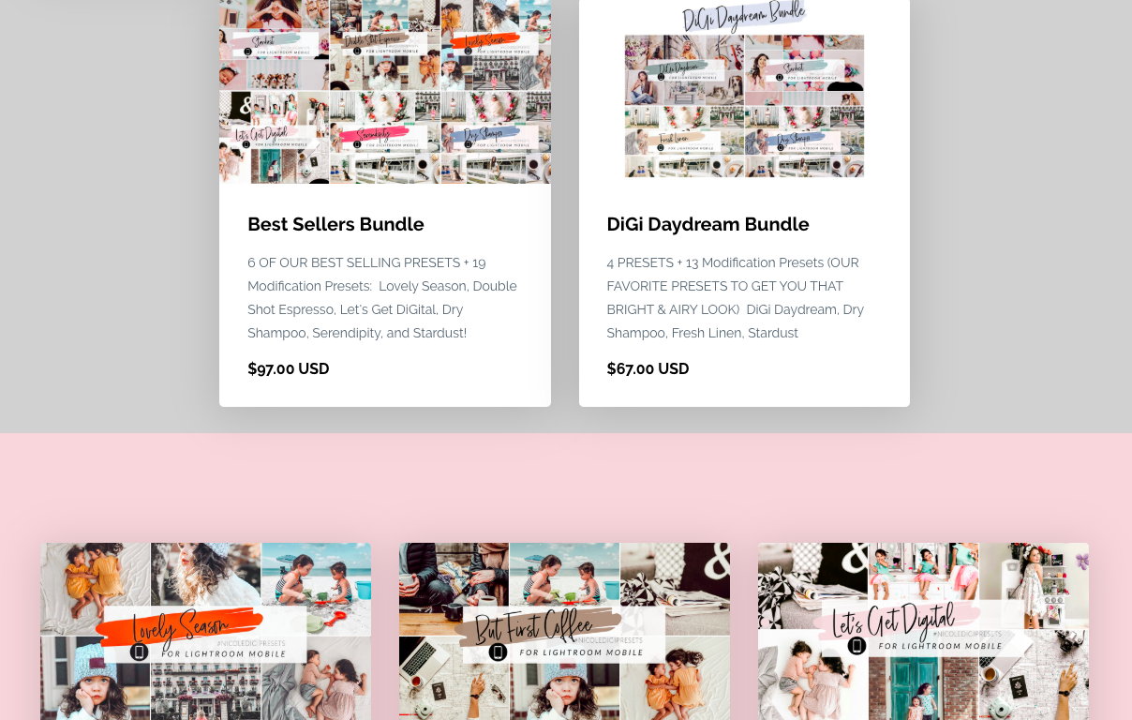

Slide 7
INSTA PICTURES
PICKING A COUPLE SPOTS FOR A SIGNATURE “MAX AND RILEY” PHOTO
EMOTIONS BEHIND BUYING
STYLES
-FULL BODY
-CLOSE UP “INFLUENCER STYLE”
-FLAT LAY

Slide 8
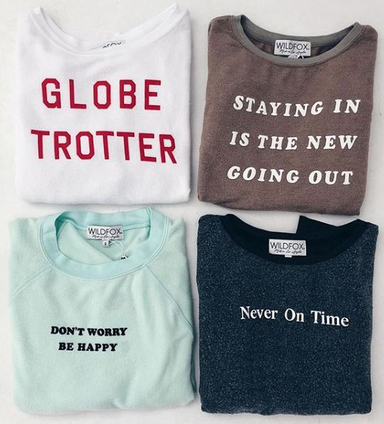
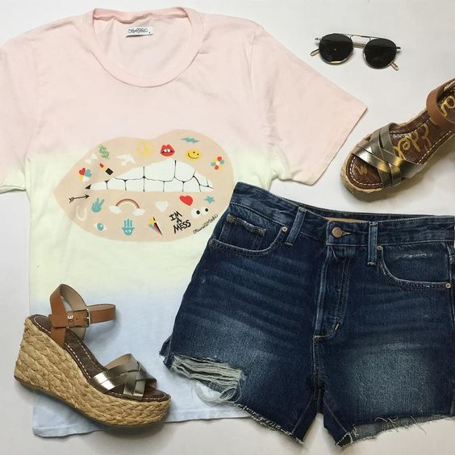
FLAT LAY - GOOD FOR PRODUCT DETAILS

Slide 9
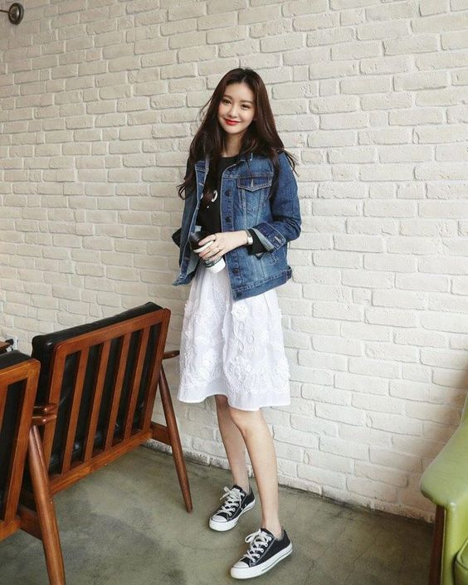
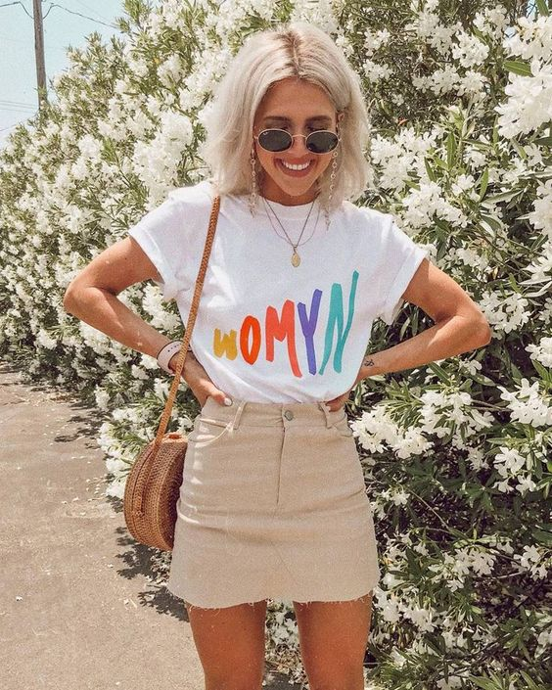
FULL BODY - GOOD FOR STYLING
GOOD FOR IMAGINING HOW ONE WOULD WEAR OR STYLE A PIECE- FEATURE SJP SHOES, STYLE W JACKET, ETC.

Slide 10
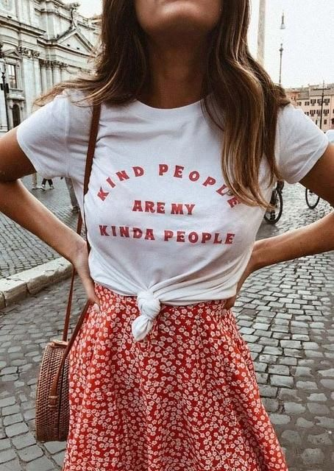
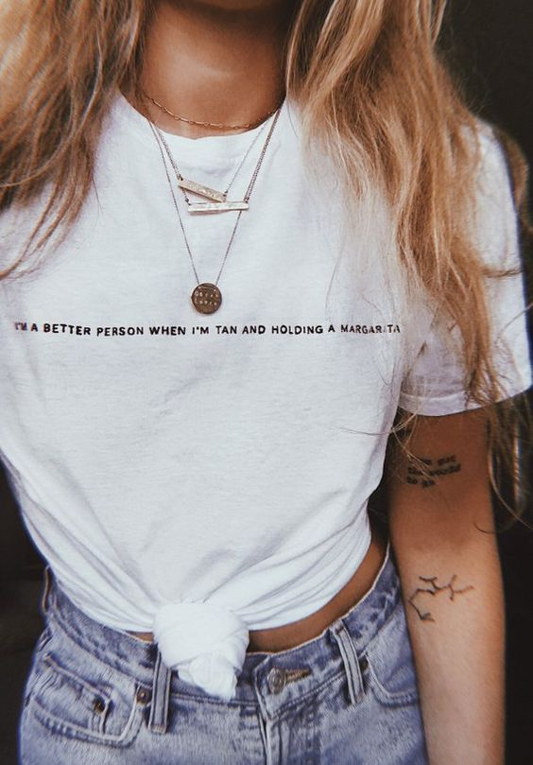
CLOSE UP - DETAIL
GOOD FOR INCLUDING BAGS, JEWERLY, BELTS, ETC. TO SHOWCASE

Slide 11
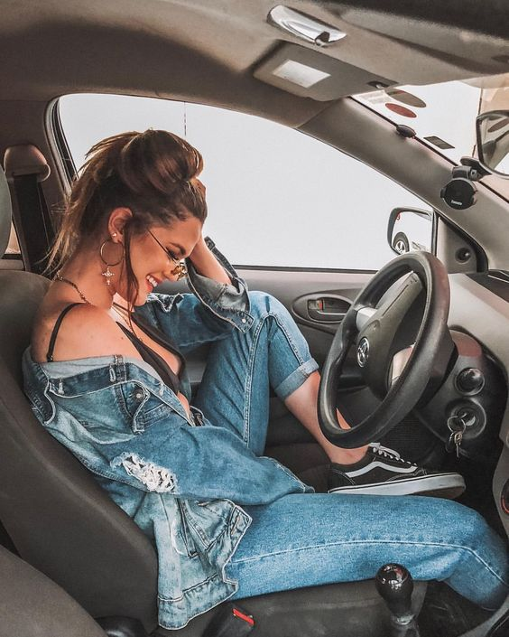
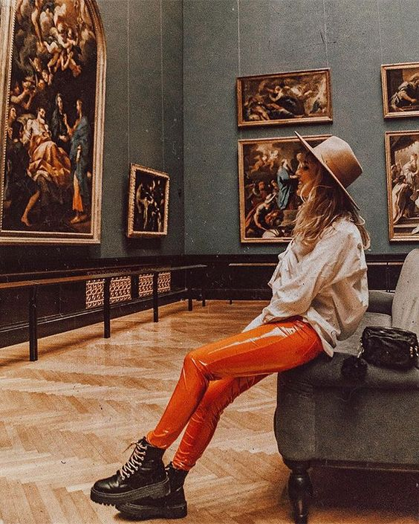
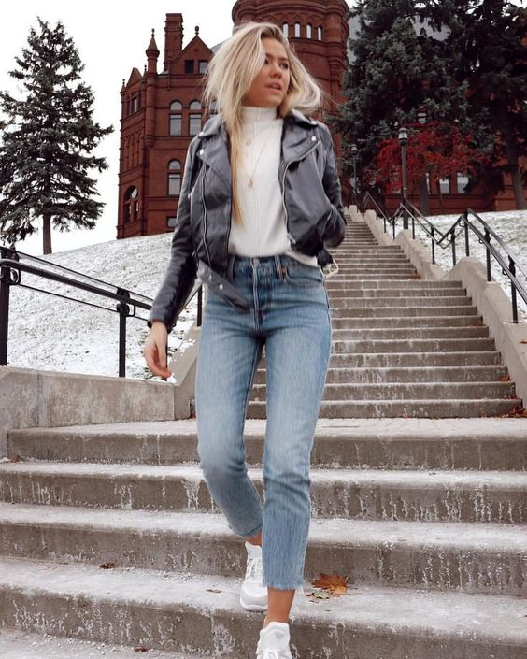
PLACES TO SHOOT
THINK FALL- ON CAMPUS, CAR, MUSEUM - EMOTIONS BEHIND, IMAGINING HOW YOU WOULD WEAR.

Slide 12
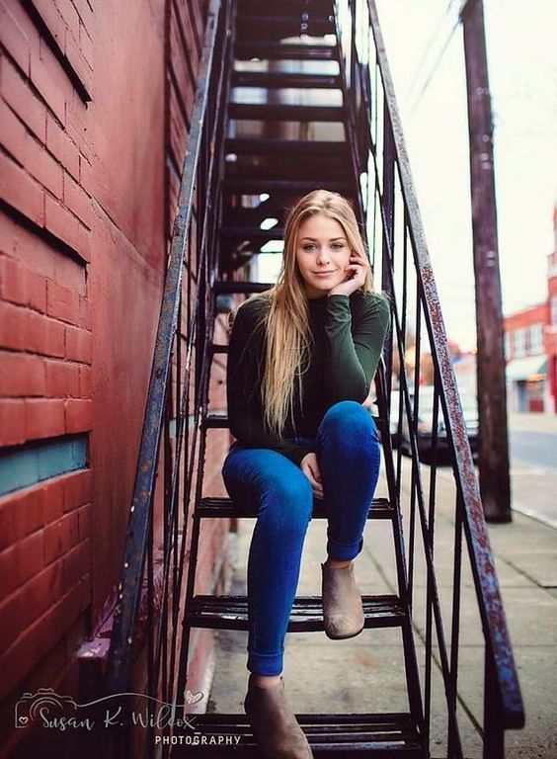
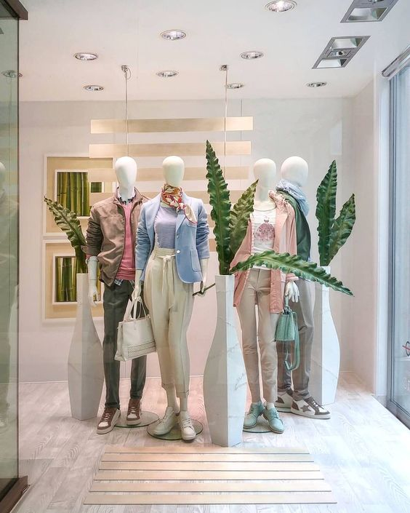
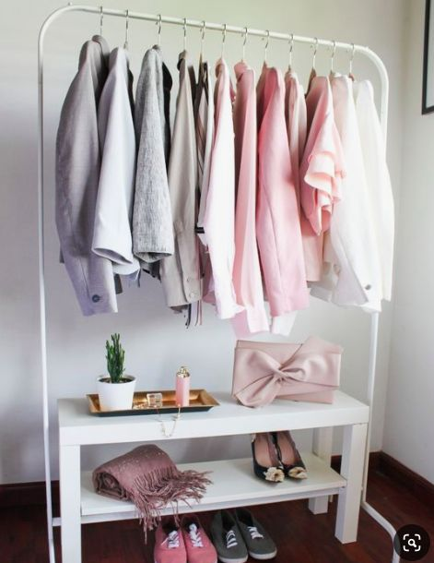
IN AND AROUND STORE
PERSONALITY AND AESTHETIC OF STORE- VOICE OF BRAND

Slide 13
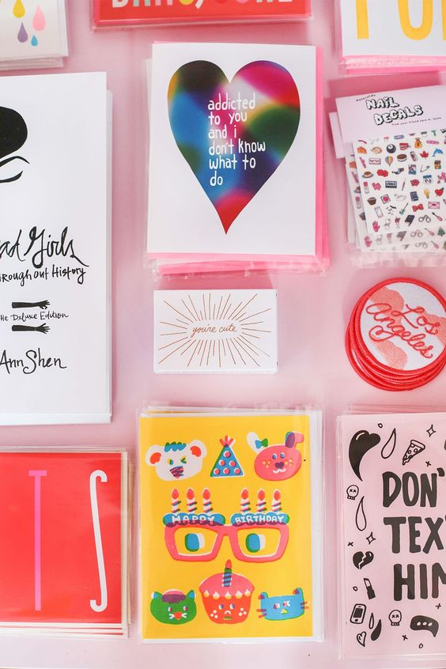
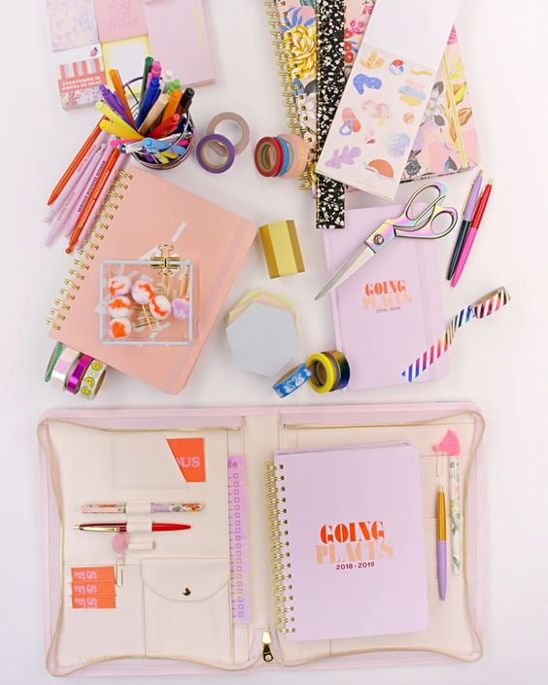
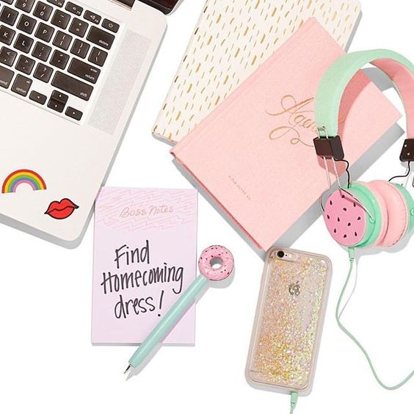
FEATURED BRANDS - BANDO
GIRL BOSS - SCHOOL & OFFICE

Slide 14
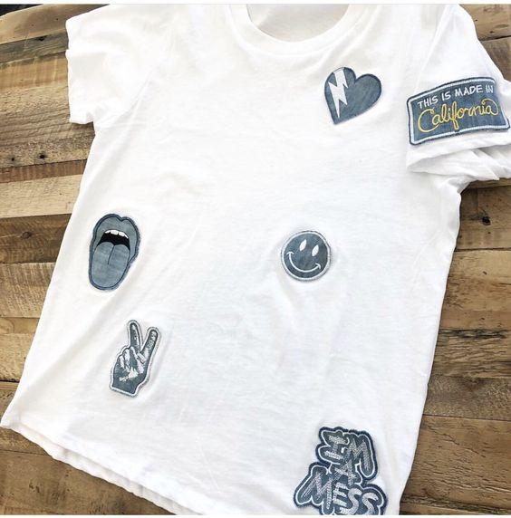
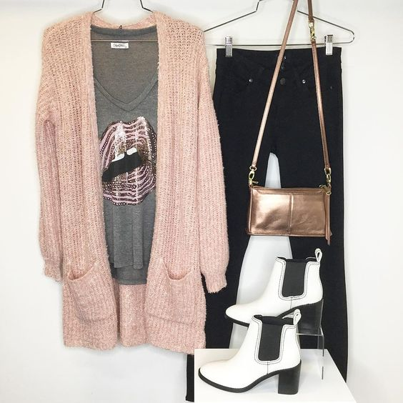
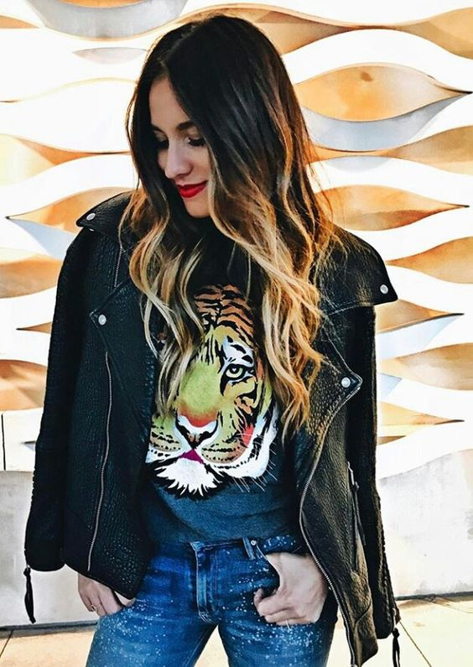
FEATURED BRANDS- LAUREN MOSHI

Slide 15
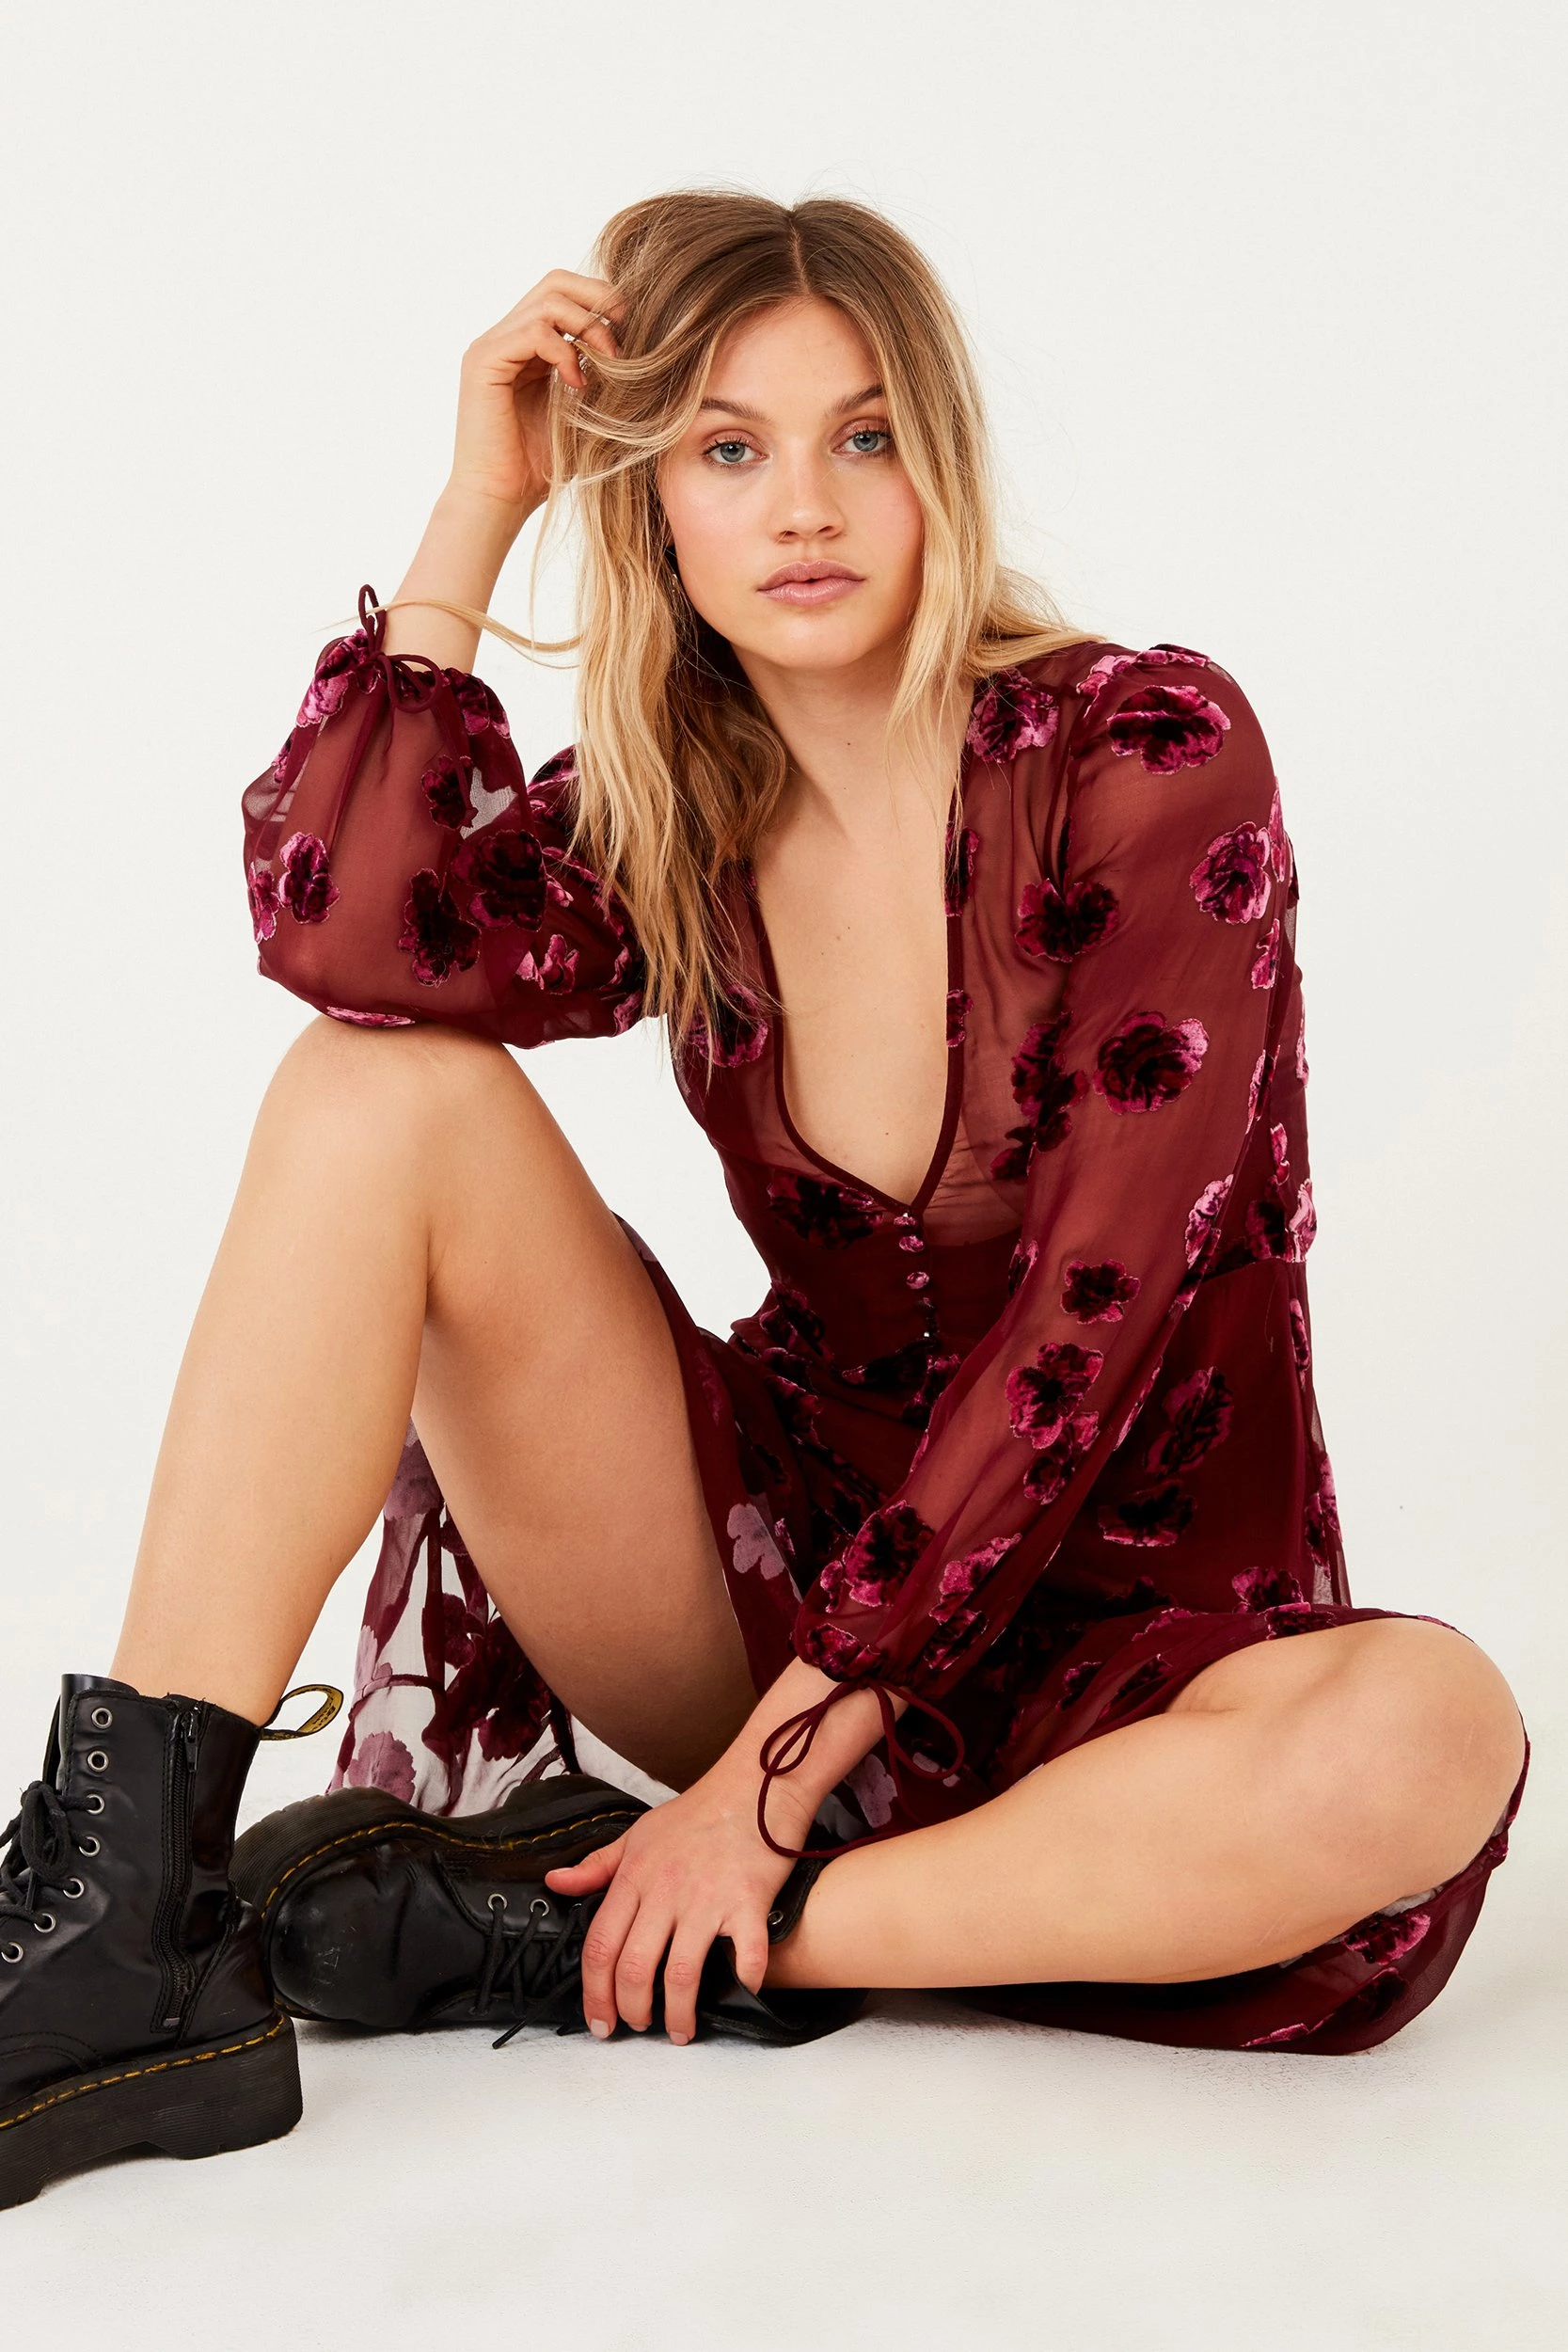
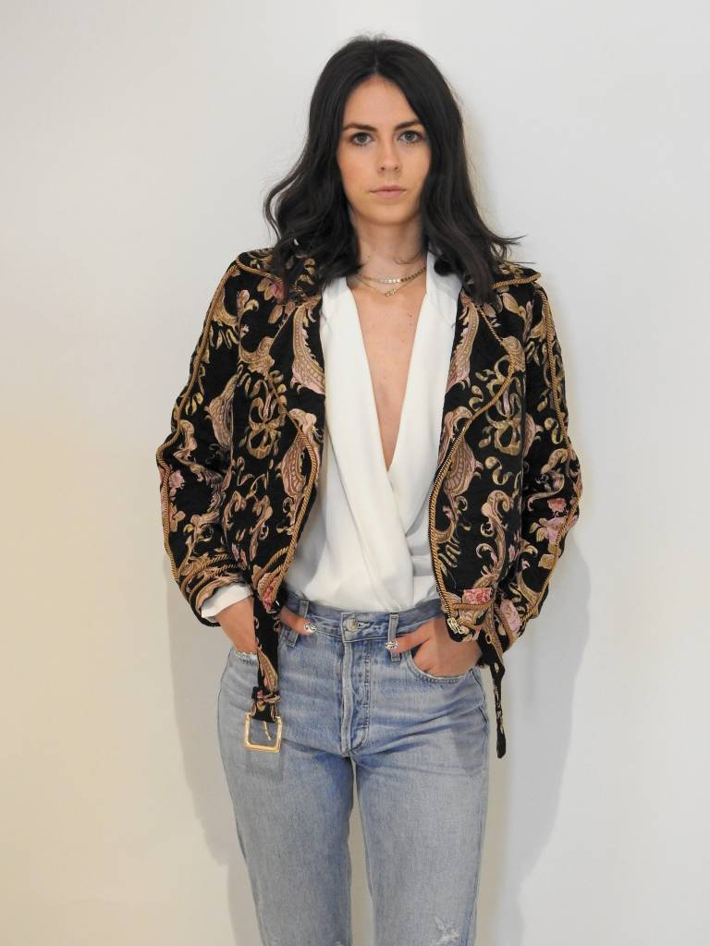
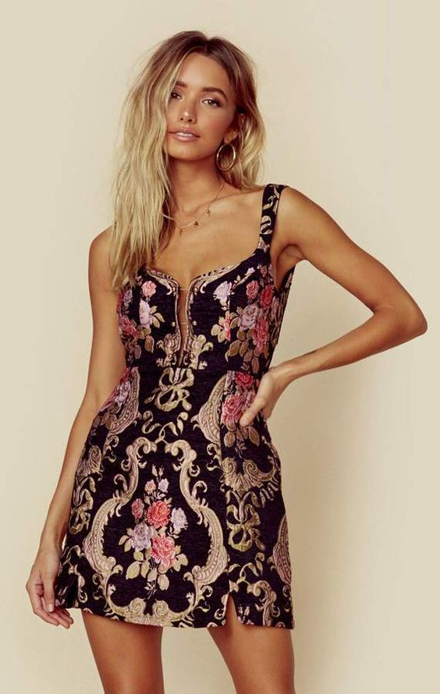
FOR LOVE AND LEMONS
Focus on styling bold pieces, fall colors & aesthetic - romantic

Slide 16
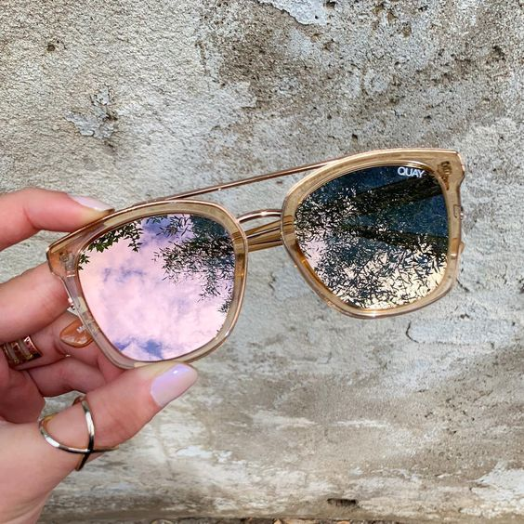
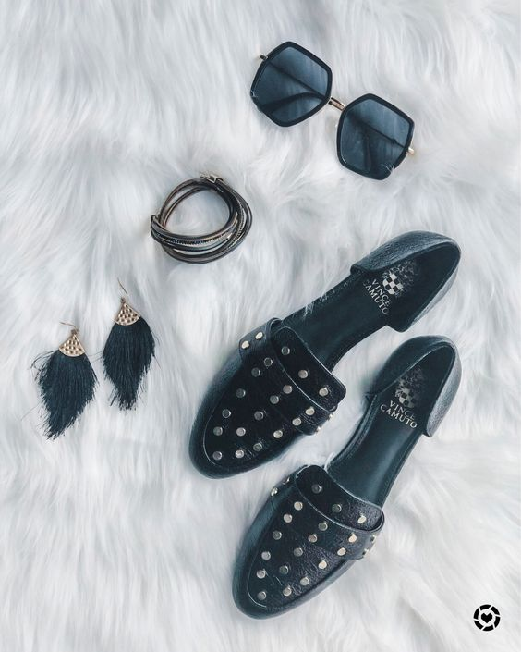
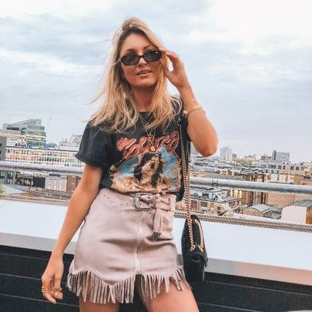
QUAY AUSTRALIA
Style with featured pieces.
Flay lay of accessories.
Feature that Max and Riley carries, right downtown.

Slide 17
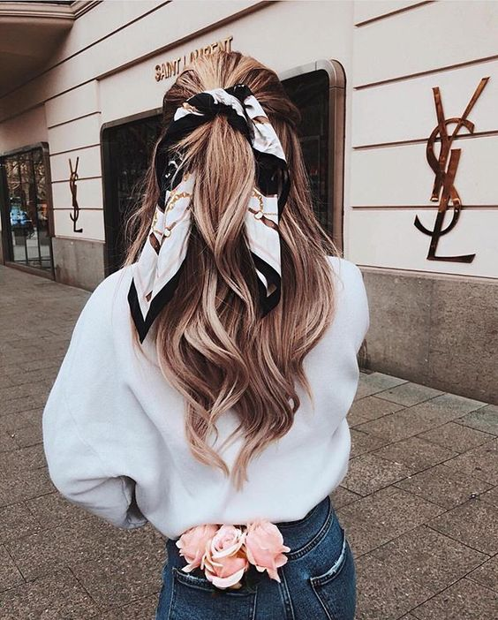
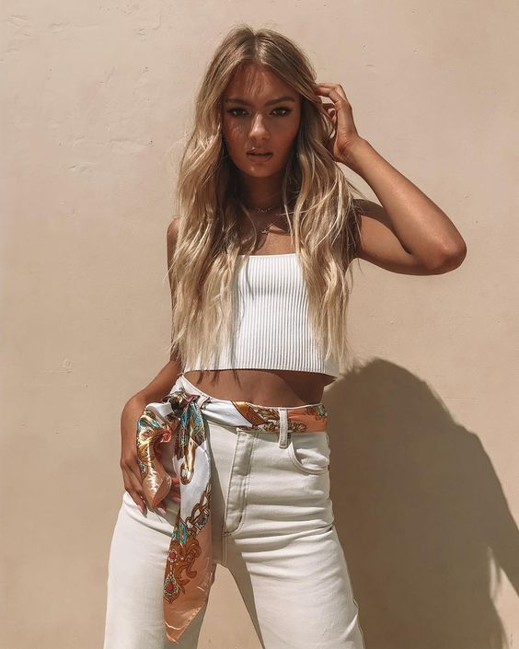
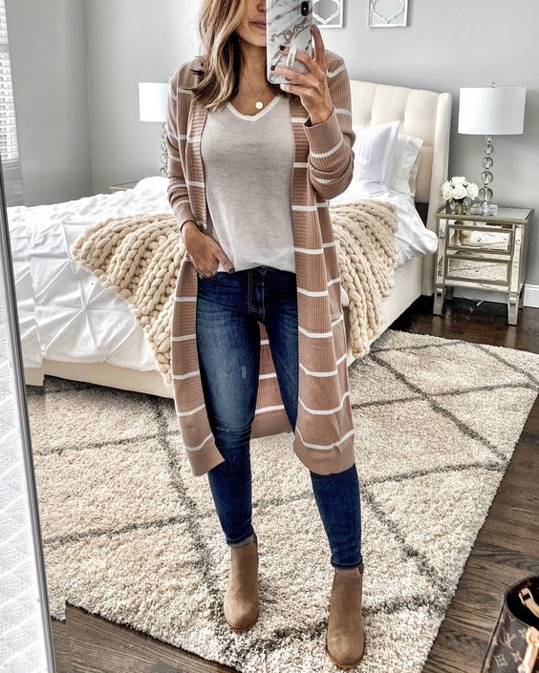
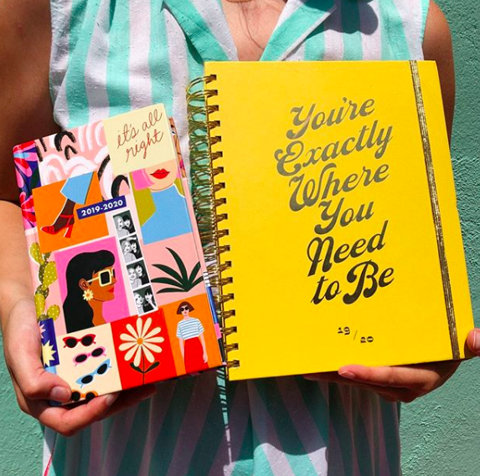
ACCESSORIES, SCARFS JEWERLY MOM BLOGGERS

Slide 18
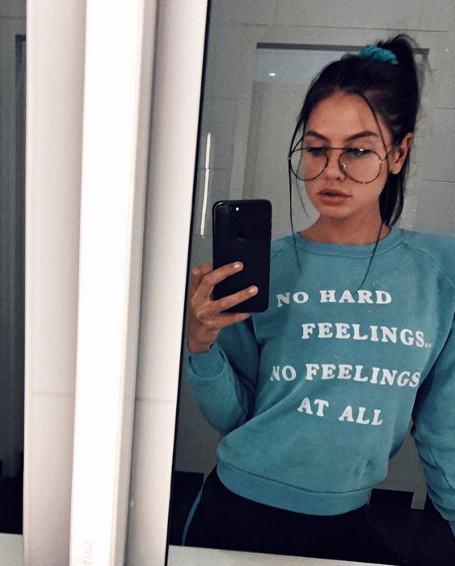
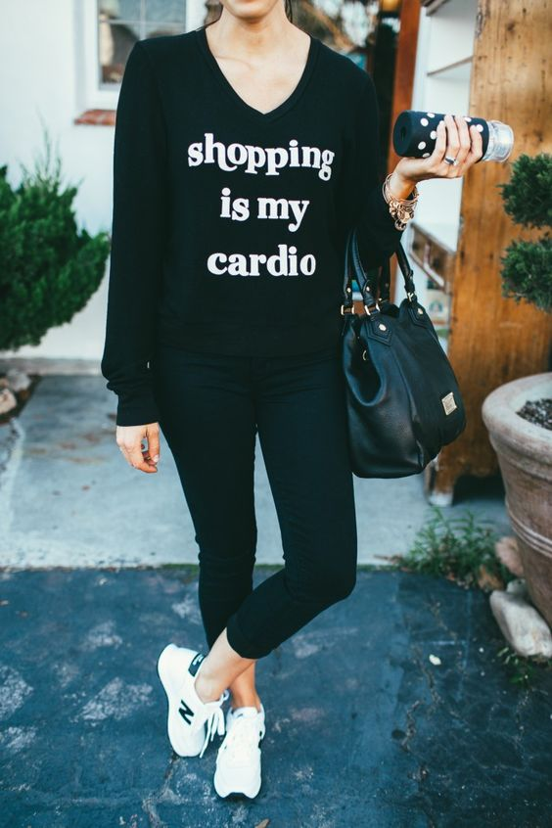
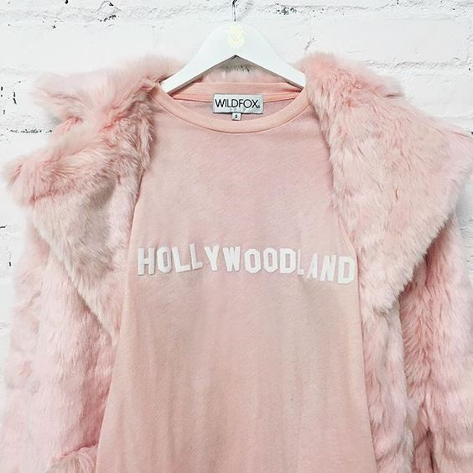
FEATURED BRANDS - WILDFOX

Slide 19
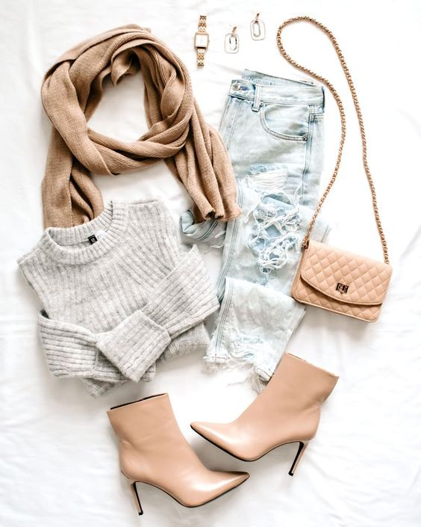
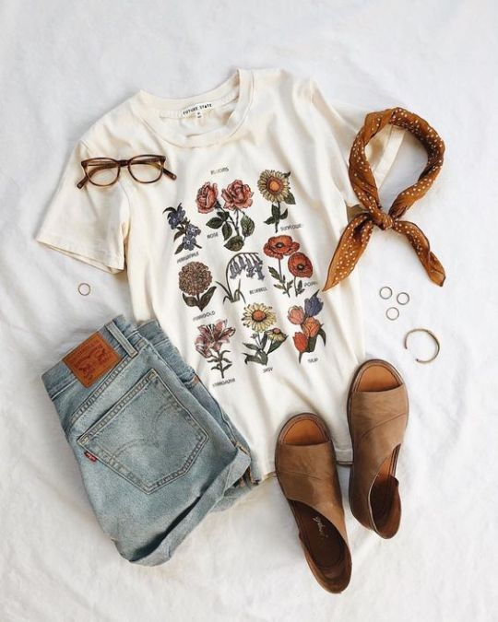
MORE FLAT LAY IDEAS

Slide 20
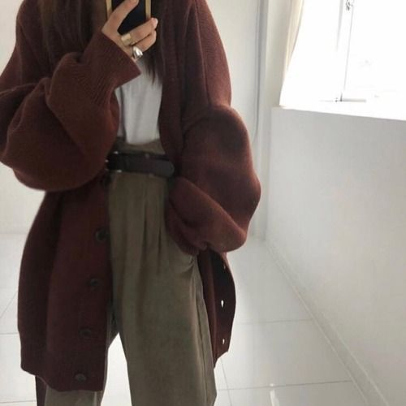
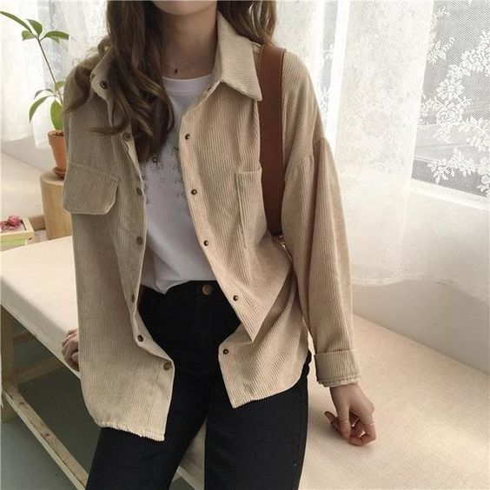
FULL BODY- FOCUSED ON CLOTHING

Slide 21
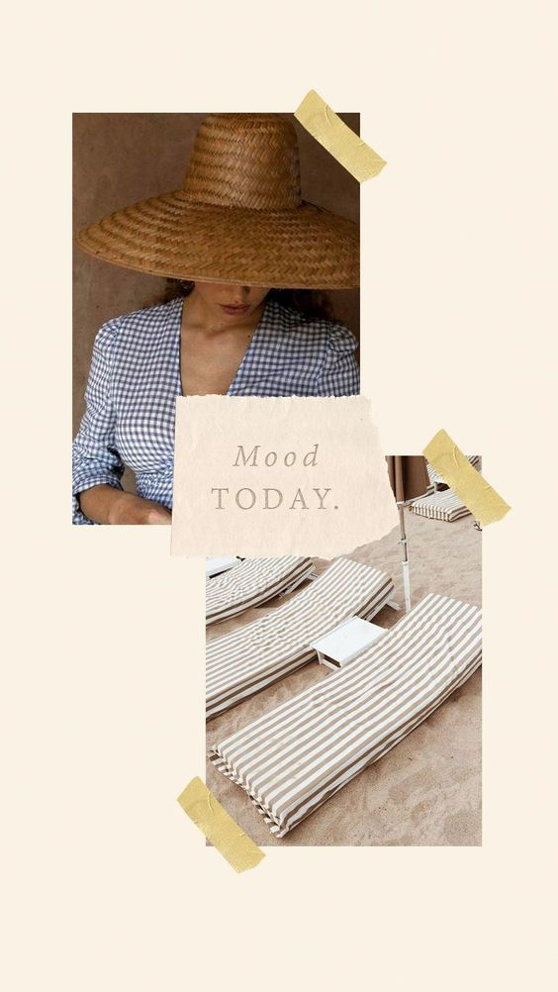
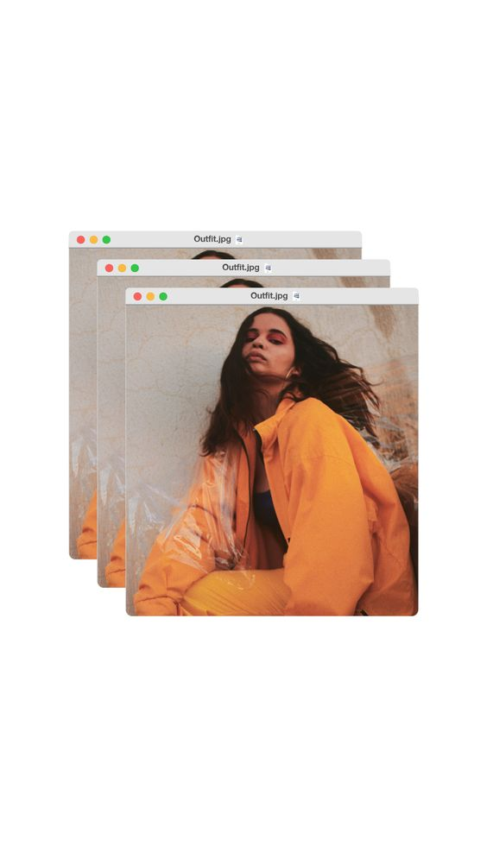
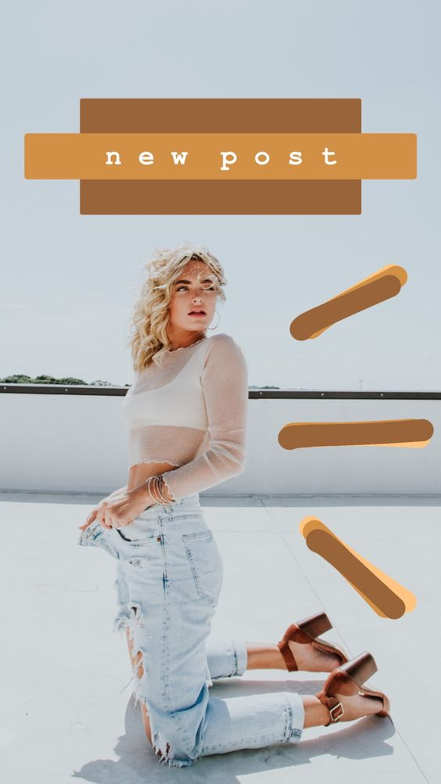
INSTAGRAM STORIES IDEAS- ON TREND

Slide 22
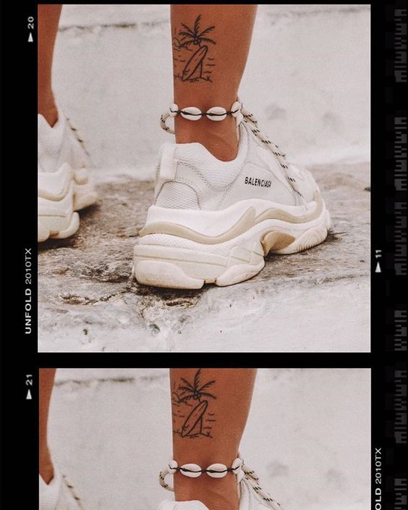
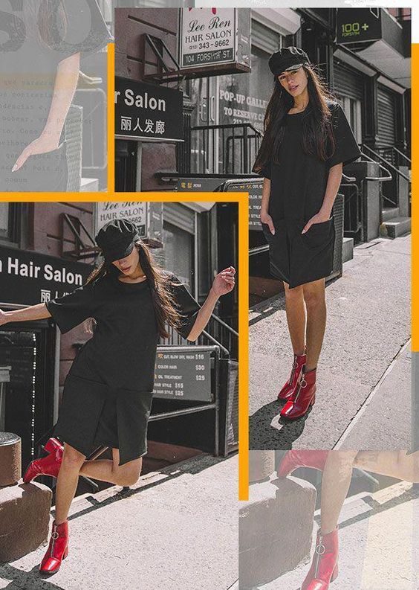
80s/90s STYLE IS VERY IN

Slide 23
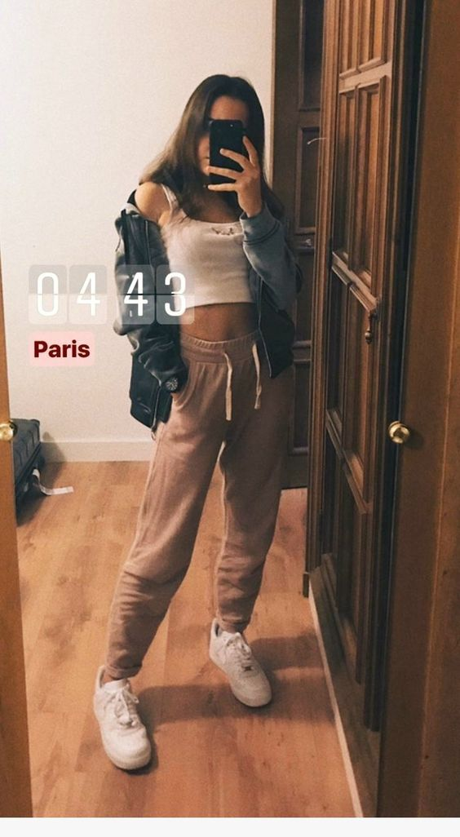
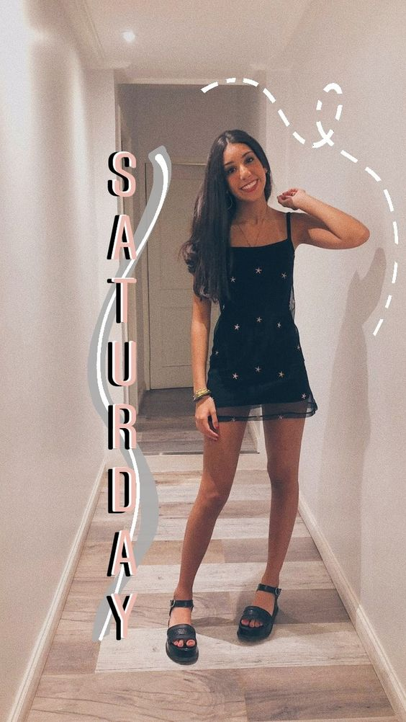
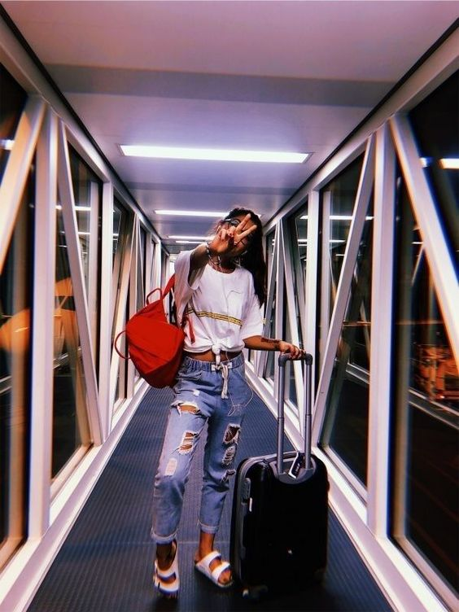
STORIES CONT.

Slide 24
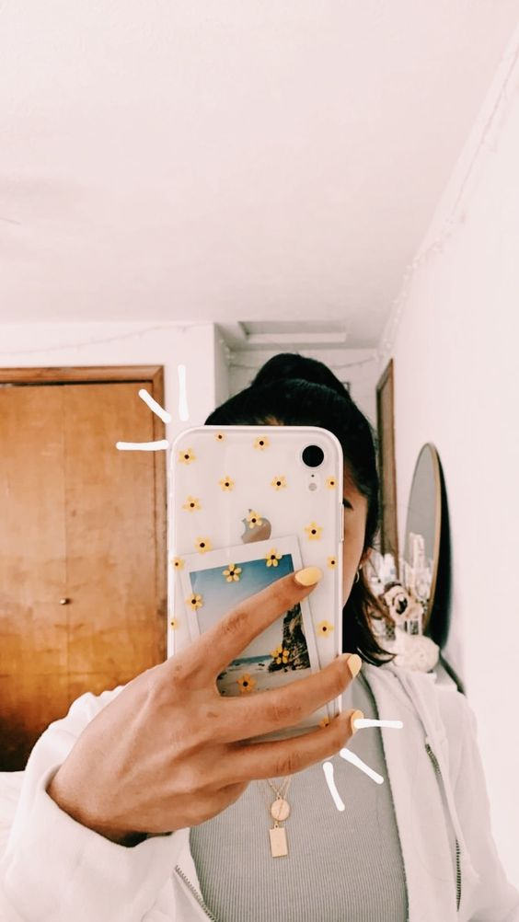
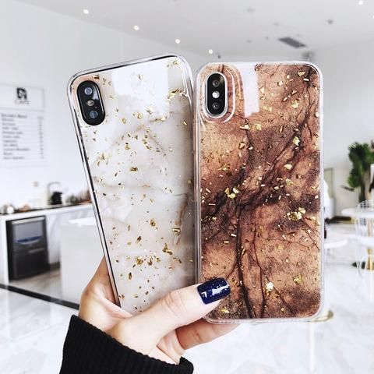
ACCESSORY IDEAS- FOR STORIES AND POSTS

Slide 25
THINGS TO MENTION/HIGHLIGHT
STUDENT DISCOUNT
TOP BRANDS
FEATURED PIECES

